Slide 1
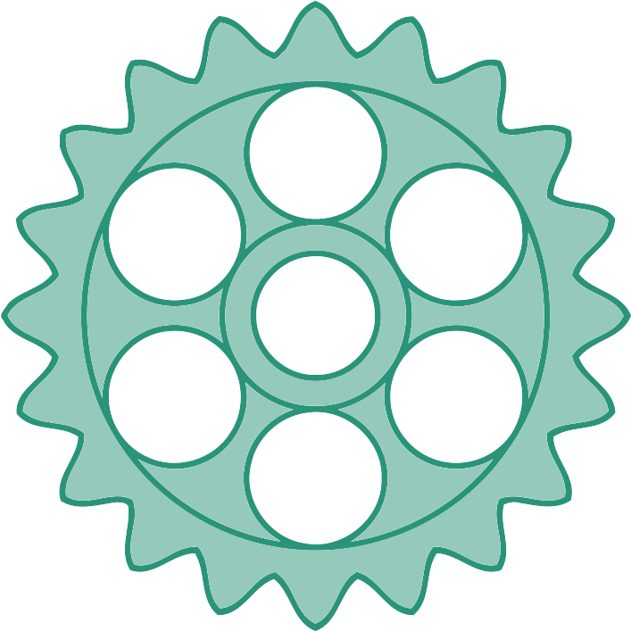

Version Control
“What one programmer can do in one month, two programmers can do in two months.”
– Fred Brooks
Notes:
1 min

Slide 2
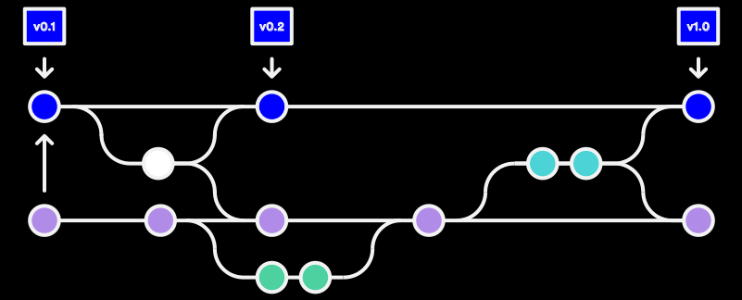
Version Control: Why?
Programmers are…
Awesome, and…
Brilliant, but…
Human, and…
Must work together.
We must plan to fail. Version control (revision control, source control) protects us from our own stupidity and faulty nature by storing changes!
Notes:
4.5 min

Slide 3
Version Control Basics
Version control…
Is based on commits
Can have branches
Supports merging
Usually supports tags
Tag
Commit
Stable
Bugfix
Backport
Branches
Development
Experimental
Merge
Notes:
9.5 min

Slide 4
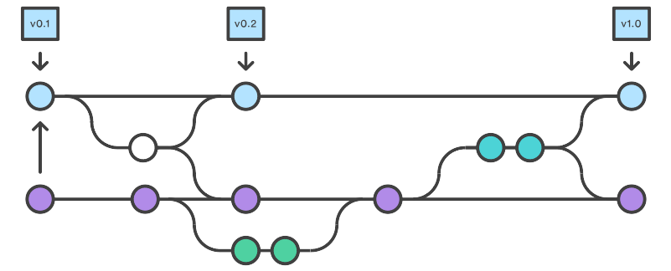
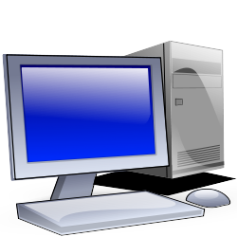
Git: Distributed Version Control
Git is a distributed version control system.
Everyone has a copy of the repository
May or may not have central repository
Commits are local until they are pushed
“Commit early and often” (low cost)
Notes:
7 min

Slide 5
Distributed VCS: Clone
A clone operation makes a copy of a repository locally.
Note: a clone does not capture any future commits!
Notes:
1.5 min

Slide 6
Distributed VCS: Commit
Performing a commit creates a changeset from one version to another.
New Commit
changes
Notes:
1 min

Slide 7
Distributed VCS: Push
A push operation pushes any changes up to a remote repository.
Notes:
1 min

Slide 8
Distributed VCS: Pull
A pull operation pulls down any changes made to the remote repository.
Notes:
1.5 min

Slide 9
And now for a demonstration…
There are many tools that can be used for Git repositories.
I usually use the SourceTree GUI app on Windows and MacOS, but YMMV.
Recommendations for command line (you’ll need one of these):
Windows 11 – Windows Subsystem for Linux (i.e., Ubuntu on Windows)
MacOS – Type ‘git’ from a terminal.
Linux – Type ‘git’ from a terminal. Probably. (Insert CLI black magic here.)
Notes:
3 min (demo?)

